Slide 1

22년 삼성 AI 전문가과정
6월 9일 목요일 4교시
장병탁
인공지능
19차시 : Vision
서울대학교 컴퓨터공학부
담당 교수: 장병탁
Seoul National University
Byoung-Tak Zhang

Slide 2
Lecture Overview
인공지능
19차시 : Vision
서울대학교 컴퓨터공학부
담당 교수: 장병탁
Seoul National University
Byoung-Tak Zhang

Slide 3
Introduction: Vision
Vision: Around 80 percent of our sensory impressions are registered through our eyes.
Most animals have eyes, often at significant cost. However, this cost is justified by the immense value that eyes provide.
An agent that can see can predict the future:
It can tell what it might bump into
It can tell whether to attack or to flee or to court
It can guess whether the ground ahead is swampy or firm
It can tell how far away the fruit is
In this chapter, we describe how to recover information from the flood of data that comes from eyes or cameras.

Slide 4
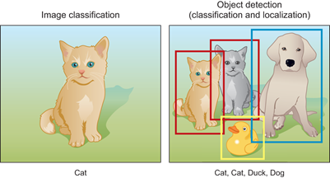
Detecting Objects
Image classifiers
Predict what is in the image
Object detectors
Find multiple objects in an image, report what class each object is, and report where each object is by giving a bounding box around the object
Looking at a small sliding window onto the larger image—a rectangle
Classify what we see in the window
출처: Figure #4
출처: Figure #5

Slide 5
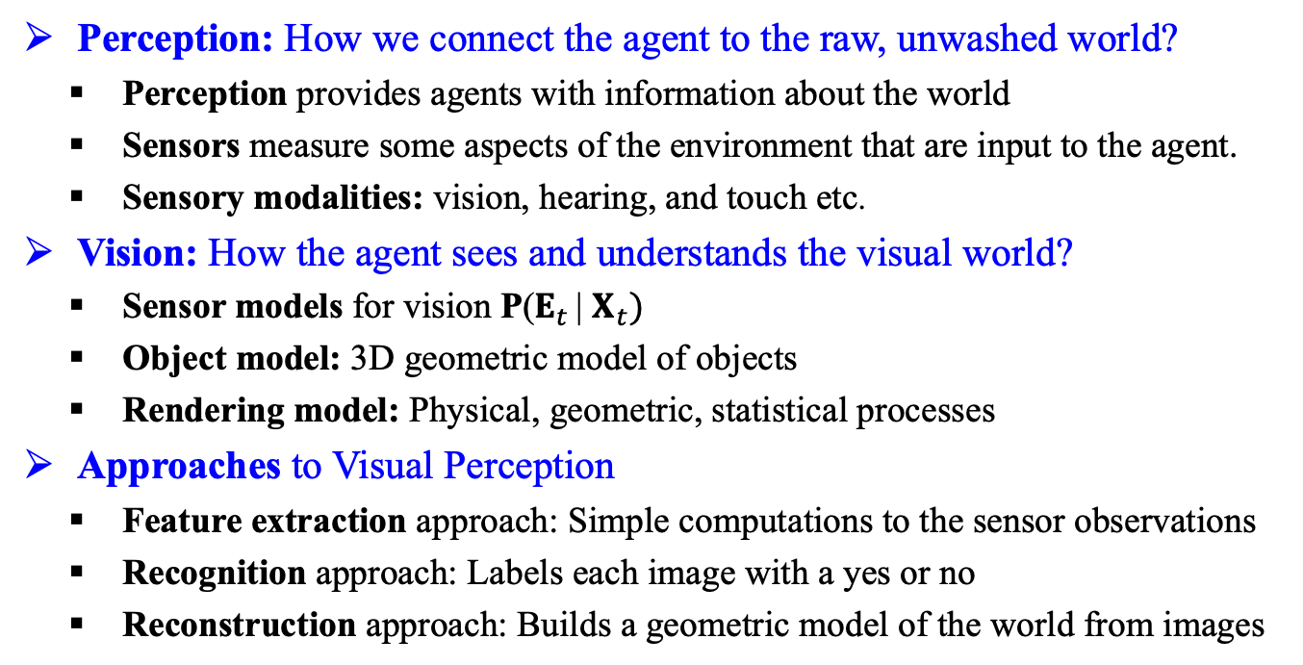
Visual Perception
Perception: How we connect the agent to the raw, unwashed world?
Perception provides agents with information about the world
Sensors measure some aspects of the environment that are input to the agent.
Sensory modalities: vision, hearing, and touch etc.
Vision: How the agent sees and understands the visual world?
Sensor models for vision P($E_{t}$ | $X_{t})$
Object model: 3D geometric model of objects
Rendering model: Physical, geometric, statistical processes
Approaches to Visual Perception
Feature extraction approach: Simple computations to the sensor observations
Recognition approach: Labels each image with a yes or no
Reconstruction approach: Builds a geometric model of the world from images

Slide 6
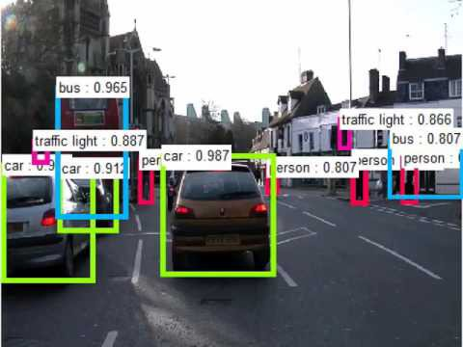
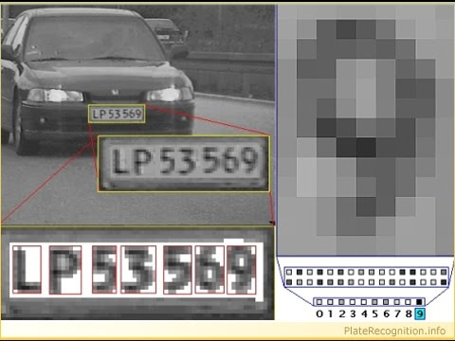
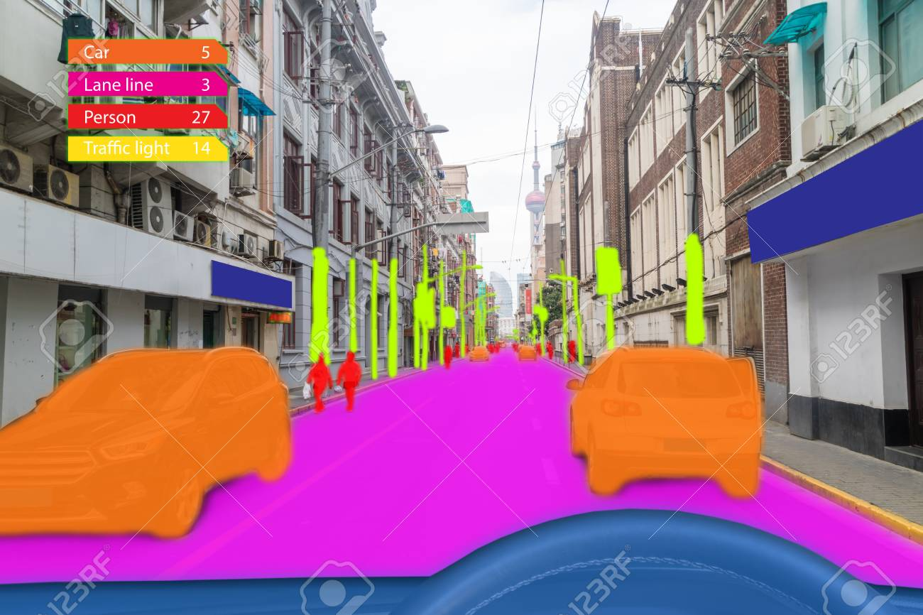
Applications
Self-driving cars
Machine inspection
Optical character recognition (OCR)
3-D model building (photogrammetry)
Retail (e.g. automated checkouts)
Medical imaging
Automotive safety
Match move
Motion capture (mocap)
Surveillance
Fingerprint recognition and biometrics
출처: Figure #1
출처: Figure #2
출처: Figure #3

Slide 7
Outline (Lecture 19)
19.1 Introduction ..........................................................
19.2 Image Formation ..................................................
19.3 Simple Image Features .........................................
19.4 Classifying Images ...............................................
19.5 Detecting Objects .................................................
19.6 The 3D World .......................................................
19.7 Using Computer Vision ........................................
Summary .......................................................................
7
9
13
22
27
32
35
43

Slide 8
19.1 Introduction

Slide 9
19.1 Introduction (1/1)
Vision
A perceptual channel that accepts a stimulus and reports some representation of the world
Feature
A number obtained by applying simple computations to an image
The model-based approach to vision
Object model
Rendering model: describes the physical, geometric, and statistical processes
Two core problems of computer vision
Reconstruction: an agent builds a model of the world from an image
Recognition: an agent draws distinctions among the objects

Slide 10
19.2 Image Formation

Slide 11
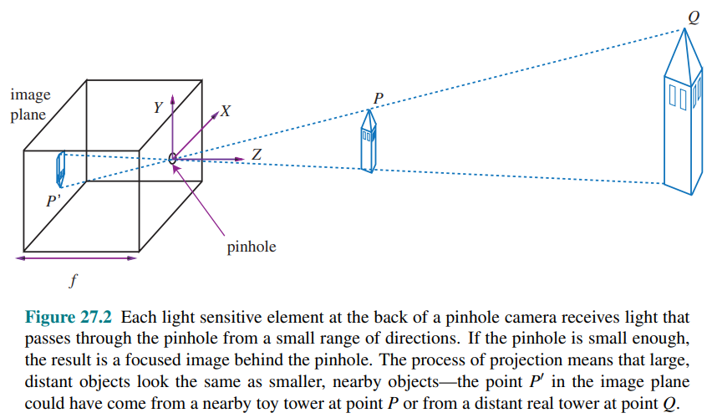
19.2 Image Formation (1/3)
Images without lenses: The pinhole camera
출처: Figure #6

Slide 12
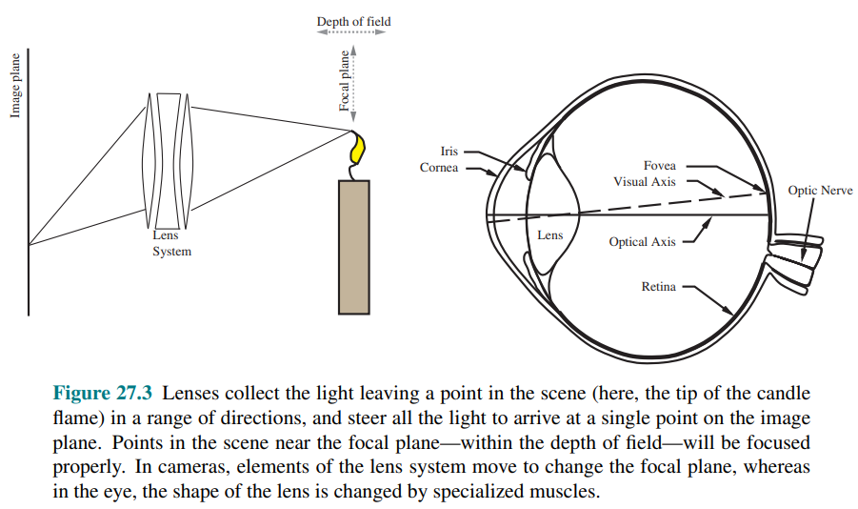
19.2 Image Formation (2/3)
Lens systems
A single piece of transparent tissue in the eye and a system of multiple glass lens elements in a camera
A camera (or an eye) with a lens captures all the light that hits anywhere on the lens
출처: Figure #7

Slide 13
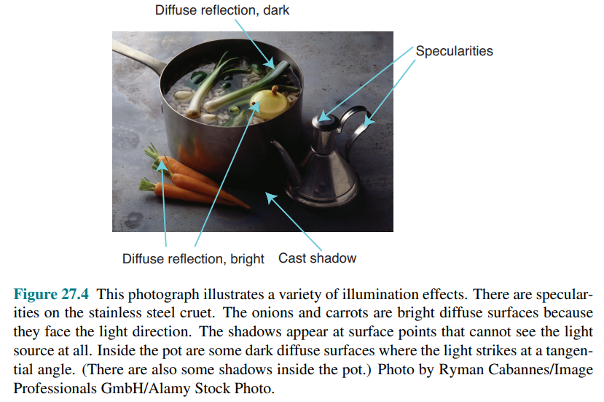
19.2 Image Formation (3/3)
Light and shading
출처: Figure #8

Slide 14
19.3 Simple Image Features

Slide 15
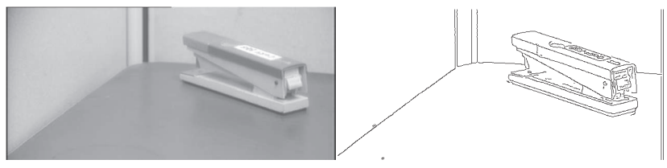
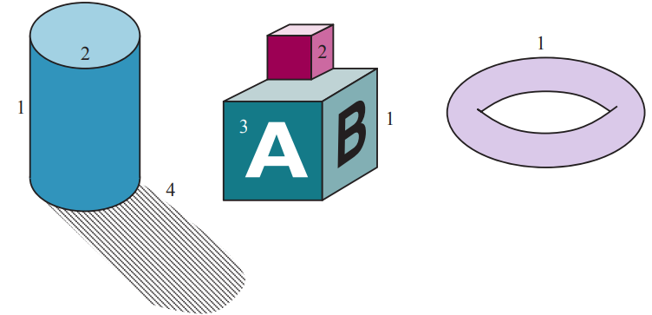
19.3 Simple Image Features (1/8)
Edge detection
Edges are straight lines or curves in the image plane across which there is a “significant” change in image brightness.
Kinds of edges
1. Depth discontinuities
2. Surface orientation discontinuities
3. Reflectance discontinuities
4. Illumination discontinuities
(shadows)
출처: Figure #9
출처: Figure #10

Slide 16
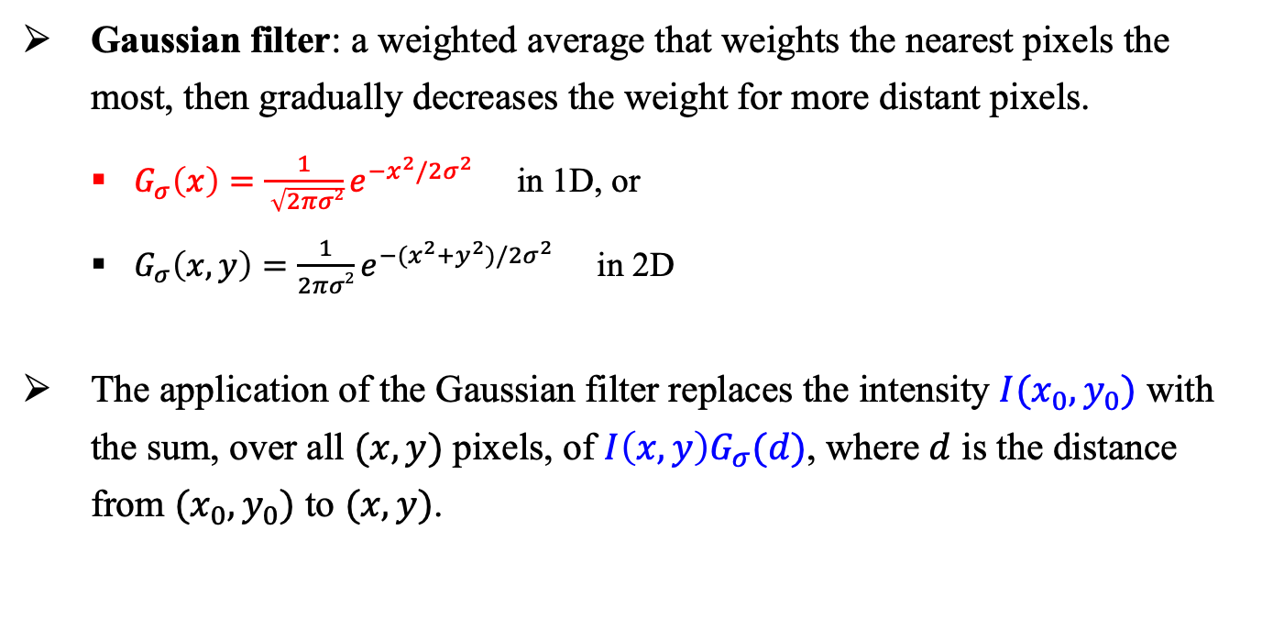
19.3 Simple Image Features (2/8)
Gaussian filter: a weighted average that weights the nearest pixels the most, then gradually decreases the weight for more distant pixels.
$G_{σ}\left(x\right)=\frac{1}{ \sqrt{2πσ2}}e^{−x^{2}/2σ^{2}}$ in 1D, or
$G_{σ}\left(x,y\right)=\frac{1}{2πσ2}e^{−{(x}^{2}+y^{2})/2σ^{2}}$ in 2D
The application of the Gaussian filter replaces the intensity $I(x_{0},y_{0})$ with the sum, over all $(x,y)$ pixels, of $I\left(x,y\right)G_{σ}(d)$, where $d$ is the distance from $(x_{0},y_{0})$ to $(x,y)$.

Slide 17
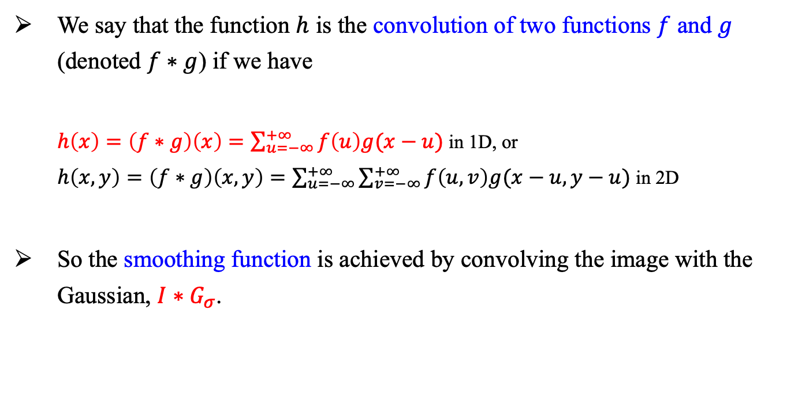
19.3 Simple Image Features (3/8)
We say that the function $h$ is the convolution of two functions $f$ and $g$ (denoted $f∗g$) if we have
$h\left(x\right)=\left(f∗g\right)\left(x\right)=\sum_{u=−∞}^{+∞}{f\left(u\right)g(x−u)}$ in 1D, or
$h\left(x,y\right)=\left(f∗g\right)\left(x,y\right)=\sum_{u=−∞}^{+∞}{\sum_{v=−∞}^{+∞}{f\left(u,v\right)g(x−u,y−u)}}$ in 2D
So the smoothing function is achieved by convolving the image with the Gaussian, $I∗G_{σ}$.

Slide 18
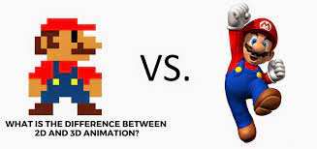
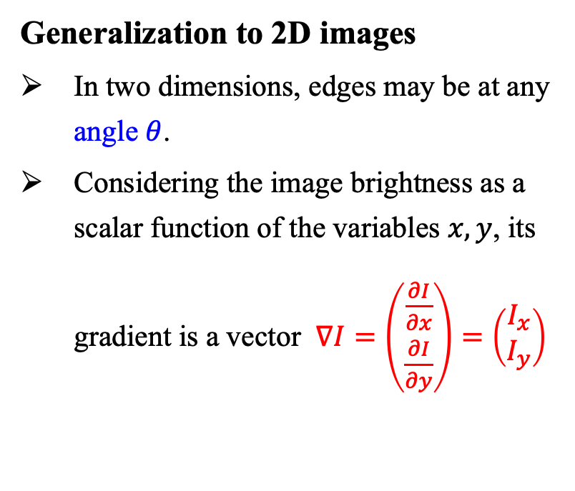
19.3 Simple Image Features (4/8)
Generalization to 2D images
In two dimensions, edges may be at any angle $θ$.
Considering the image brightness as a scalar function of the variables $x, y$, its gradient is a vector $∇I=\left(\begin{aligned}\frac{∂I}{∂x} \\ \frac{∂I}{∂y}\end{aligned}\right)=\left(\begin{aligned}I_{x} \\ I_{y}\end{aligned}\right)$

Slide 19
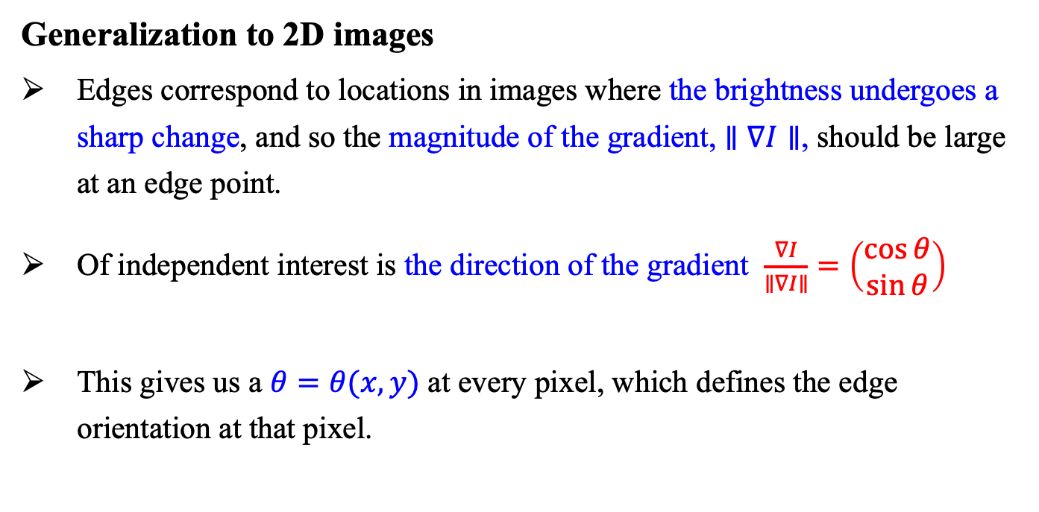
19.3 Simple Image Features (5/8)
Generalization to 2D images
Edges correspond to locations in images where the brightness undergoes a sharp change, and so the magnitude of the gradient, $∥∇I∥$, should be large at an edge point.
Of independent interest is the direction of the gradient $\frac{∇I}{∥∇I∥}=\left(\begin{aligned}\cos{θ} \\ \sin{θ}\end{aligned}\right)$
This gives us a $θ=θ(x, y)$ at every pixel, which defines the edge orientation at that pixel.

Slide 20
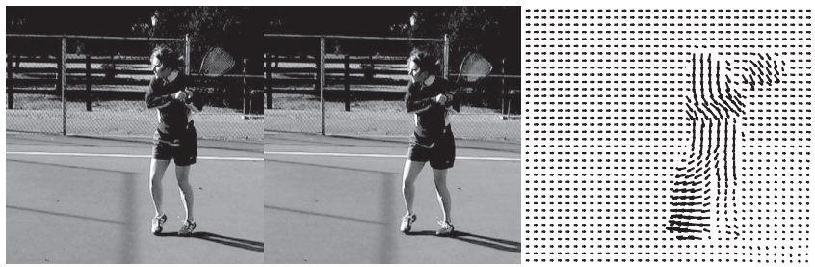
19.3 Simple Image Features (6/8)
Texture
In everyday language, texture is the visual feel of a surface—what you see evokes what the surface might feel like if you touched it.
Optical flow
When an object in the video is moving, or when the camera is moving relative to an object, the resulting apparent motion in the image is called optical flow.
출처: Figure #11

Slide 21
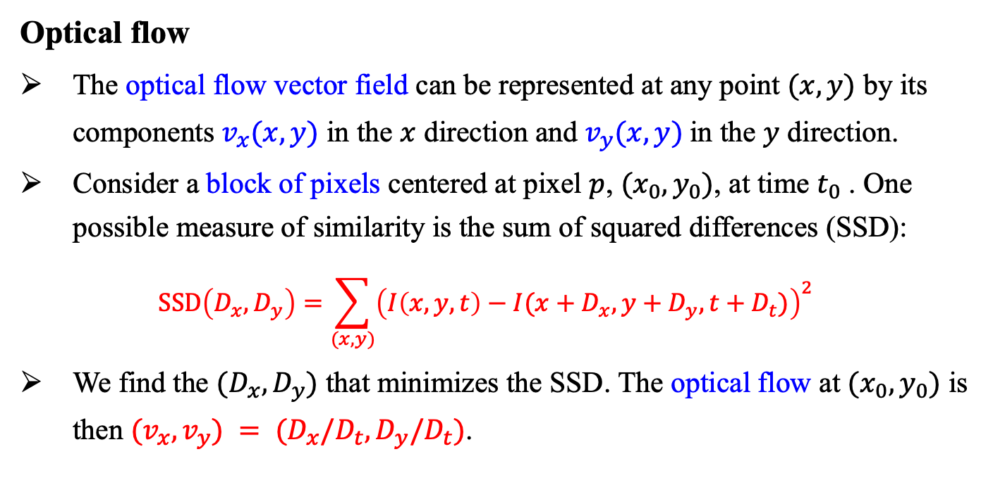
19.3 Simple Image Features (7/8)
Optical flow
The optical flow vector field can be represented at any point $(x, y)$ by its components $v_{x}(x, y)$ in the $x$ direction and $v_{y}(x, y)$in the $y$ direction.
Consider a block of pixels centered at pixel $p$, $(x_{0}, y_{0})$, at time $t_{0}$ . One possible measure of similarity is the sum of squared differences (SSD):
$$SSD\left(D_{x},D_{y}\right)=\sum_{(x,y)}{{\left(I\left(x,y,t\right)−I(x+D_{x},y+D_{y},t+D_{t})\right)}^{2}}$$
We find the $(D_{x}, D_{y})$ that minimizes the SSD. The optical flow at $(x_{0}, y_{0})$ is then $(v_{x}, v_{y}) = (D_{x}/D_{t}, D_{y}/D_{t})$.

Slide 22
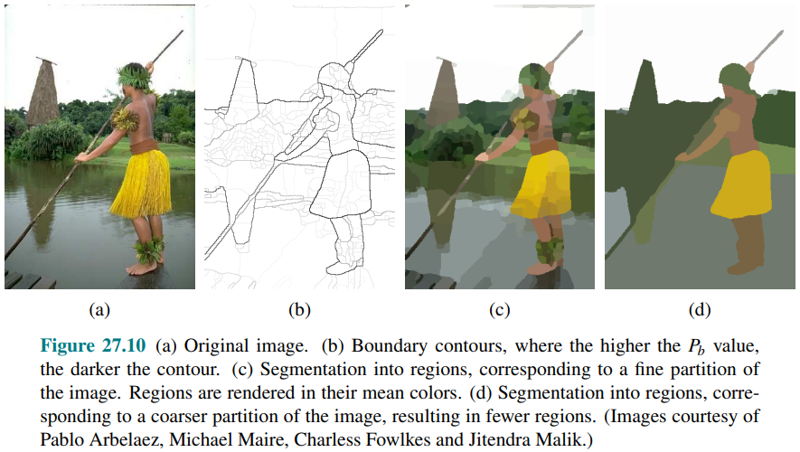
19.3 Simple Image Features (8/8)
Segmentation of images
Breaking an image into regions of similar pixels.
출처: Figure #12

Slide 23
19.4 Classifying Images

Slide 24
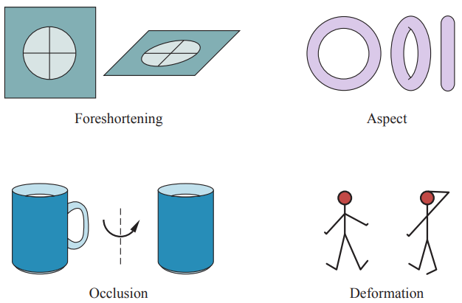
19.4 Classifying Images (1/4)
Complex appearance and pattern elements
Foreshortening, which causes a pattern viewed at a slant to be significantly distorted.
Aspect, which causes objects to look different when seen from different directions.
Occlusion, where some parts are hidden from some viewing directions.
Deformation, where internal degrees of freedom of the object change its appearance.
출처: Figure #13.1

Slide 25
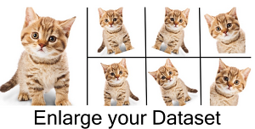
19.4 Classifying Images (2/4)
Image classification with convolutional neural networks (CNNs)
Why do CNN classify well?
Features used by CNN classifiers are learned from data not hand-crafted by a researcher
Availability of large, challenging data sets e.g. ImageNet
Detect spatial relations between local patterns
Deeper layers of convolutional neural networks represent “patterns of patterns”
Dataset augmentation
Training samples are copied and modified slightly
E.g. Shifting, Rotation, Random cropping, Padding, Resizing
출처: Figure #13.2

Slide 26
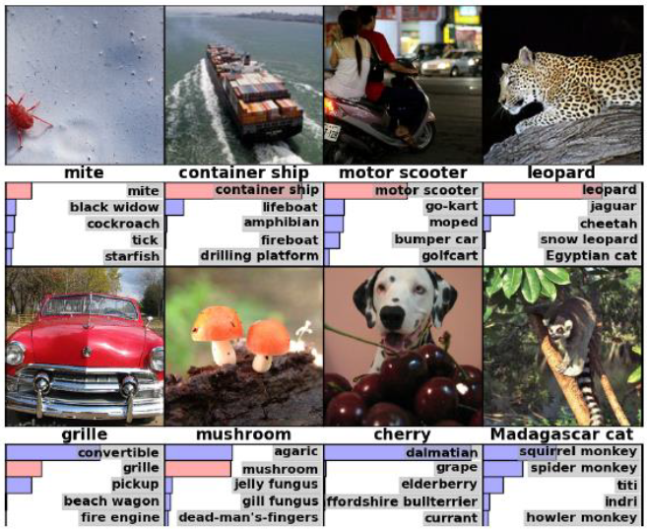
19.4 Classifying Images (3/4)
ImageNet Large-Scale Visual Recognition Challenge (LSVRC)
Image Classification/Localization
1.2M labeled images, 1000 classes
Deep learning methods won since 2012:
2012 non-CNN: 26.2% (top-5 error)
2012: (Hinton, AlexNet)15.3%
2013: (Clarifai) 11.2%
2014: (Google, GoogLeNet) 6.7%
(pre-2015): (Google) 4.9%
→ Beyond human-level performance
출처: Figure #14

Slide 27
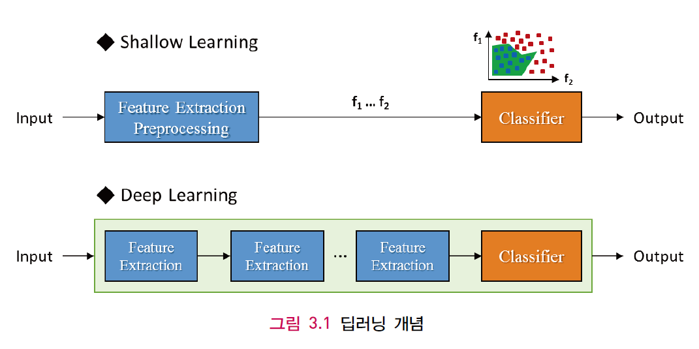
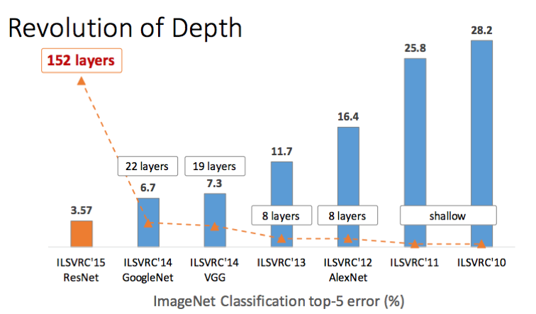
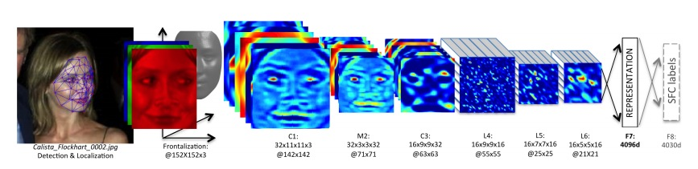

19.4 Classifying Images (4/4)
Deep convolutional networks
Depth vs. performance
출처: Figure #15
출처: Figure #17
출처: Figure #16

Slide 28
19.5 Detecting Objects

Slide 29
19.5 Detecting Objects (1/4)
Image classifiers
Predict what is in the image
Object detectors
Find multiple objects in an image, report what class each object is, and report where each object is by giving a bounding box around the object
Looking at a small sliding window onto the larger image—a rectangle
Classify what we see in the window
출처: Figure #4
출처: Figure #5

Slide 30
19.5 Detecting Objects (2/4)
Details to workout
Decide on a window shape
Faster RCNN uses nine boxes: small, medium, and large sizes; and tall, wide, square aspect ratios
Build a classifier for windows
Use CNN classifier
Decide which windows to look at
Select ones that are likely to have interesting objects in them
Regional proposal network (RPN): A network that finds regions with objects
Region of interest (ROI): box with a good enough objectness score
ROI pooling: sampling the pixels to extract features

Slide 31
19.5 Detecting Objects (3/4)
Details to workout (cont.)
Choose which windows to report
Don’t want to report the same object multiple times in slightly different windows
Perhaps only the objects that appear large in the image
Non-Maximum Suppression (NMS)
First, build a sorted list Non-maximum suppression of all windows with scores over a threshold.
Then, choose the window with the highest score
Report precise locations of objects using these windows
Bounding box regression

Slide 32
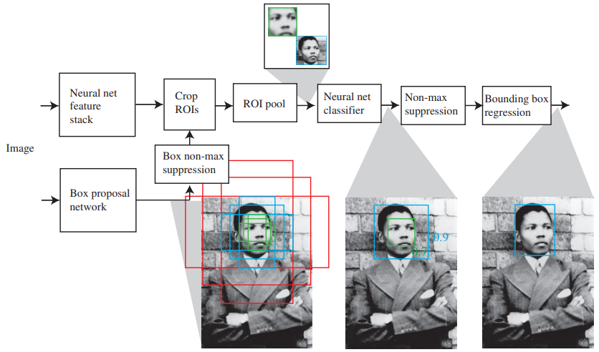
19.5 Detecting Objects (4/4)
Faster RCNN
First network computes “objectness” scores of candidate image boxes, called “anchor boxes,” centered at a grid point
Second network is a feature stack that computes a representation of the image suitable for classification
출처: Figure #21

Slide 33
19.6 The 3D World

Slide 34
19.6 The 3D World (1/2)
3D cues from multiple views
Two images of the same scene taken from different viewpoints and know enough about the two cameras
Can construct a 3D model by figuring out which point in the first view corresponds to which point in the second view + geometry
Two views of enough points, and know which point in the first view corresponds to
Do not need to know much about the cameras to construct a 3D model
Two views of two points gives you four x, y coordinates, and you only need three coordinates to specify a point in 3D space

Slide 35
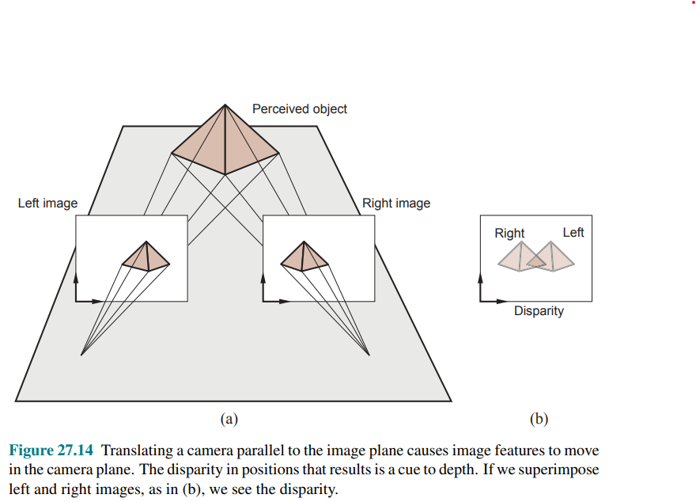
19.6 The 3D World (2/2)
Binocular stereopsis
Disparity
Try!
1) both index fingers up in front of your face, with one eye closed
2) adjust them so the front finger occludes the other finger in the open eye’s view
3) Now swap eyes
4) you should notice that the fingers have shifted position with respect to one another
출처: Figure #22

Slide 36
19.7 Using Computer Vision

Slide 37
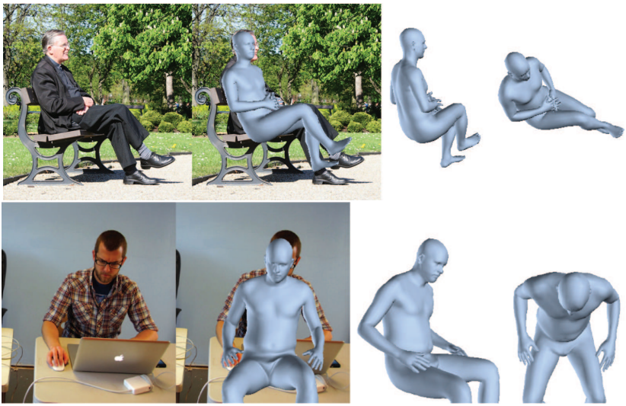
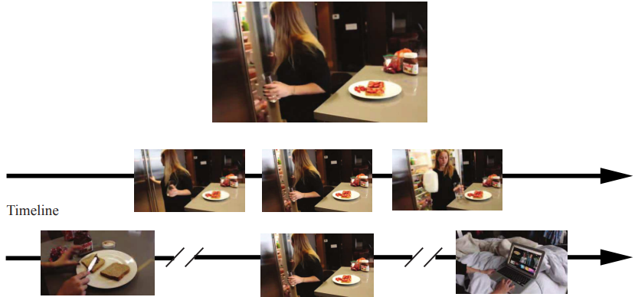
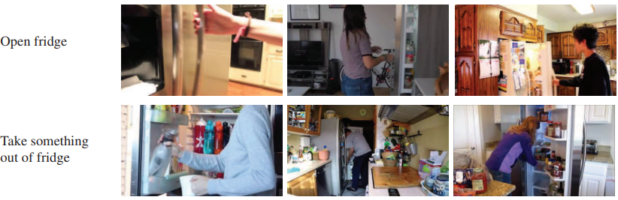
19.7 Using Computer Vision (1/7)
Understanding what people are doing
출처: Figure #24
출처: Figure #23
출처: Figure #25

Slide 38
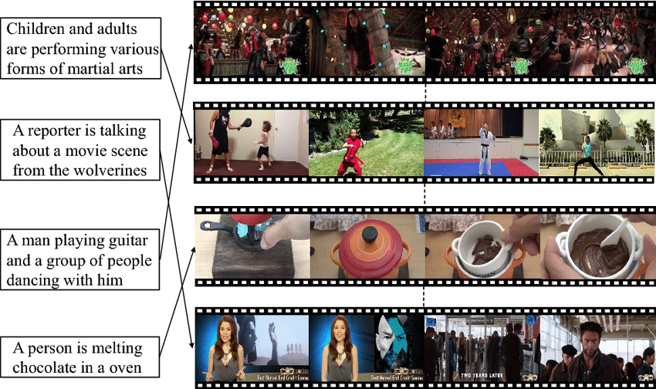
19.7 Using Computer Vision (2/7)
Linking pictures and words
How can we find the images we want?
Some of the images will have keywords or captions attached
For these, image retrieval can be like text retrieval.

Slide 39
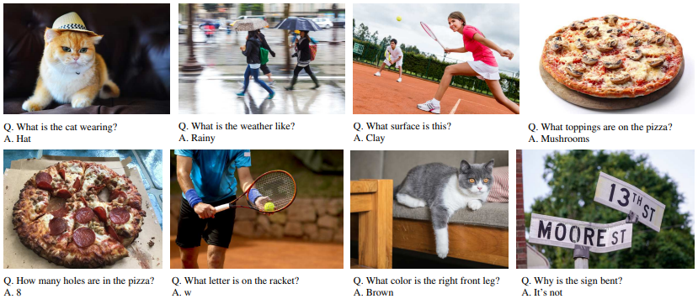
19.7 Using Computer Vision (3/7)
Linking pictures and words
Visual question-answering systems
출처: Figure #26

Slide 40
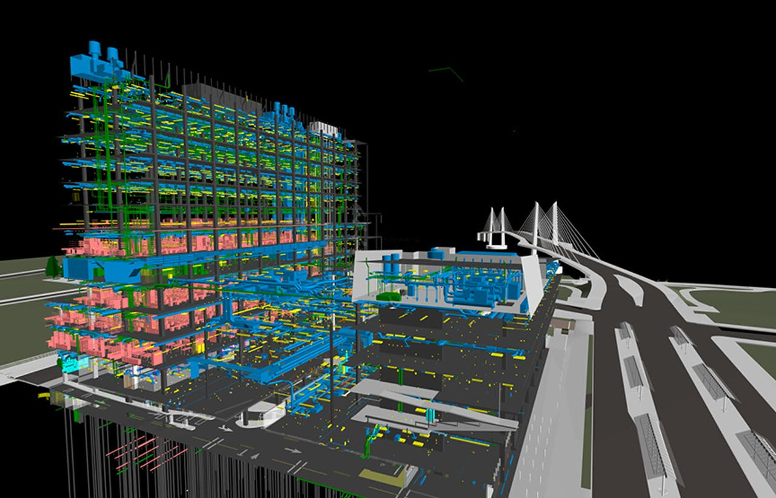
19.7 Using Computer Vision (4/7)
Reconstruction from many views
Construction management
Keeping track of what is happening during construction is difficult and expensive
Fly drones through the construction filming the current state
Build a 3D model of the current state and explore
출처: Figure #27

Slide 41
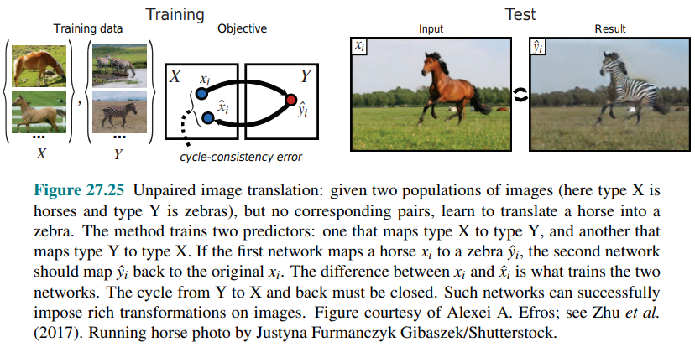
19.7 Using Computer Vision (5/7)
Making pictures
출처: Figure #28

Slide 42
19.7 Using Computer Vision (6/7)
Using vision for controlling movements
A vision system for an automated vehicle driving
Lateral control: Ensure that the vehicle remains securely within its lane
Longitudinal control: Ensure that there is a safe distance to the vehicle in front.
Obstacle avoidance: Monitor vehicles in neighboring lanes and be prepared for evasive maneuvers if one of them decides to change lanes.
Generate appropriate steering, acceleration, and braking actions to best accomplish these tasks.
The more general case of mobile robots navigating in various indoor and outdoor environments has been studied, too.

Slide 43
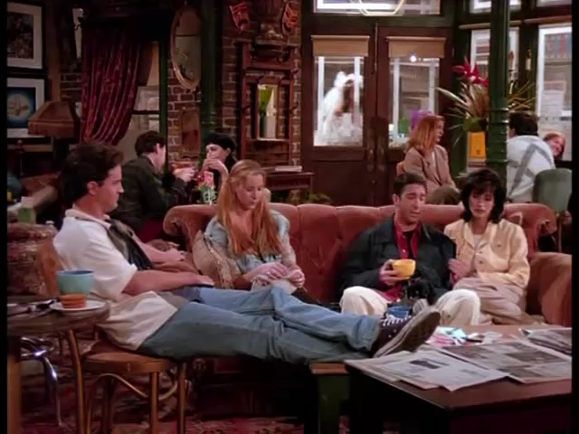
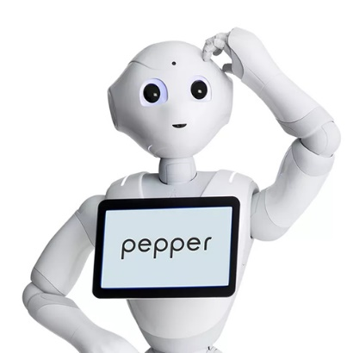
19.7 Using Computer Vision (7/7)
Video Turing Test (VTT) Project at SNU
Learn
Understand
Human Q | Who entered the café wearing a bridal dress?
Robot A | Rachel.
Human Q | Why did Rachel try to leave her fiancé?
Robot A | Because he betrayed her.
…
TV Sitcom Video “Friends” © Warner Brothers
© 2020 AIIS, SNU AI Institute

Slide 44
Summary
Although perception appears to be an effortless activity for humans, it requires a significant amount of sophisticated computation. The goal of vision is to extract information needed for tasks such as manipulation, navigation, and object recognition.
Representations of images capture edges, texture, optical flow, and regions. These yield cues to the boundaries of objects and to correspondence between images.
Convolutional neural networks produce accurate image classifiers that use learned features. Rather roughly, the features are patterns of patterns of patterns. . . . It is hard to predict when these classifiers will work well, because the test data may be unlike the training data in some important way.
Image classifiers can be turned into object detectors. One classifier scores boxes in an image for objectness; another then decides whether an object is in the box, and what object it is.
With more than one view of a scene, it is possible to recover the 3D structure of the scene and the relationship between views. In many cases, it is possible to recover 3D geometry from a single view.
The methods of computer vision are being very widely applied.

Slide 45

References
Figures
#6, 7, 8, 9, 10, 11, 12, 13.1, 22, 23, 24, 25, 26, 27, 28 Stuart J. Russell and Peter Norvig (2021). Artificial Intelligence: A Modern Approach (4rd Edition). Pearson
#13.2 https://www.kdnuggets.com/2018/05/data-augmentation-deep-learning-limited-data.html
#14 Krizhevsky, Alex, Ilya Sutskever, and Geoffrey E. Hinton. "Imagenet classification with deep convolutional neural networks." Advances in neural information processing systems 25 (2012).
#15 장병탁. 장교수의 딥러닝. 홍릉과학출판사, 2017.
#16 Taigman, Yaniv, et al. "Deepface: Closing the gap to human-level performance in face verification." Proceedings of the IEEE conference on computer vision and pattern recognition. 2014.
#17 Delivering competitive advantage to companies creating and using vision and machine learning technology https://www.bdti.com/InsideDSP/2017/06/29/Microsoft

Slide 46
References
Figures
#1, 19 https://int.search.myway.com/search/AJimage.jhtml?&n=78674121&p2=%5EBSB%5Echr999%5ETTAB02%5E&pg=AJimage&pn=2&ptb=37D82E3B-48C7-47BB-A51A-347A9F03E0D2&qs=&searchfor=optical+character+recognition&si=&ss=sub&st=tab&tpr=sbt&trs=wtt&ots=1590294714543&imgs=1p&filter=on&imgDetail=true
#2, 20 https://int.search.myway.com/search/AJimage.jhtml?&enc=0&n=78674121&p2=%5EBSB%5Echr999%5ETTAB02%5E&pg=AJimage&pn=1&ptb=37D82E3B-48C7-47BB-A51A-347A9F03E0D2&qs=&searchfor=scene+understanding&si=&ss=sub&st=tab&tpr=sbt&trs=wtt&imgs=1p&filter=on&imgDetail=true
#3 https://int.search.myway.com/search/AJimage.jhtml?&enc=0&n=78674121&p2=%5EBSB%5Echr999%5ETTAB02%5E&pg=AJimage&pn=1&ptb=37D82E3B-48C7-47BB-A51A-347A9F03E0D2&qs=&searchfor=scene+understanding&si=&ss=sub&st=tab&tpr=sbt&trs=wtt&imgs=1p&filter=on&imgDetail=true
#4 https://int.search.myway.com/search/AJimage.jhtml?&n=78674121&p2=%5EBSB%5Echr999%5ETTAB02%5E&ptb=37D82E3B-48C7-47BB-A51A-347A9F03E0D2&qs=&si=&ss=sub&st=tab&trs=wtt&tpr=sbt&enc=2&searchfor=fSOrccErETqNBTaUBd9A8w99viweJWdZ2j_cF0xVQ8mf9yQNM4-5WtDD42-PRPE8ZN7z0zWqv_pYJBiS19egEEIEHKdBZrZWN_R6m9RflvbETdL6GWC7j0OnNZUiA-GoQyZCb_M2_JC4d2UEoZMiPaCqo1zHjdldaeMtLjygu7R0-nrV7i0-qOPGyWq3Kn0kMph69BAXLj3glCfbKkcHZl0lzE6t-IXvOLMBuyGCvpBNtYrWumcrDOrMCs9IJ8JrpNOlvd57zWUnzGQOerjrnb3G54QkKVT-fwQoS4GEGTHgc90CCTsUUa1okqy1got-rPVbeYrXYjHqzIJRNqxC9Q&ts=1590286927954&imgs=1p&filter=on&imgDetail=true
#5 https://int.search.myway.com/search/AJimage.jhtml?&n=78674121&p2=%5EBSB%5Echr999%5ETTAB02%5E&pg=AJimage&pn=6&ptb=37D82E3B-48C7-47BB-A51A-347A9F03E0D2&qs=&searchfor=car+detection&si=&ss=sub&st=tab&tpr=sbt&trs=wtt&ots=1590287197619&imgs=1p&filter=on&imgDetail=true

